Slide 1
Lockery
Smart Cylinder locker and key
By moshe rimok

Slide 2
About the project
The project aims to solve the using complexity of a lock and a key pair by having a single Lockery key that potentially can unlock any Lockery lock that allowed to accept the key’s ID or the user fingerprint
The smart cylinder acts like a regular cylinder but has more capabilities and meets more advanced security principles.
The key has the same purpose as a normal key but has some sensors to communicate with the cylinder and to let the user some indications about the lock or key state.
The full project descrption can be found here The project schemas and tinkerCAD simulation files are in my Github repository

Slide 3
Product Description - Lockery lock
The cylinder accepts the keys and locks/unlocks itself. When the cylinder detects a key (via NFC) it asks for the key’s ID and if it has set up to require fingerprints it also asks the key’s fingerprint hashes. when a match is found the lock / unlock operation can be done, otherwise it will beep to inform the user that the operation failed.
The lock can be connected to the internet in order to sync its state and upload its state data to and with the cloud

Slide 4
Product Description - Lockery lock
The lock consists of:
1. Power supply connection. 2. NFC reader. 3. WIFI adapter. 4. Buttons. 5. Beeper module (sound) 6. Type-C USB socket (manage cylinder by PC/MAC app)

Slide 5
Product Description - Lockery lock
The lock is based on an Arduino controller. It uses a micro-servo to lock and unlock the cylinder. It has an NFC reader in order to read the ID of the accepted key or the user’s fingerprint.
It has 3 push buttons and a separate LED for each push button. The first button is used to enable / disable the WIFI feature The second button is used to reset the device to the initial settings and unlock the cylinder The third button is used to pair a new key to the system by either the key ID and/or the user fingerprint.
The lock has a beeper on it in order to inidcate the operation status
The lock depends on a power supply in order to work

Slide 6
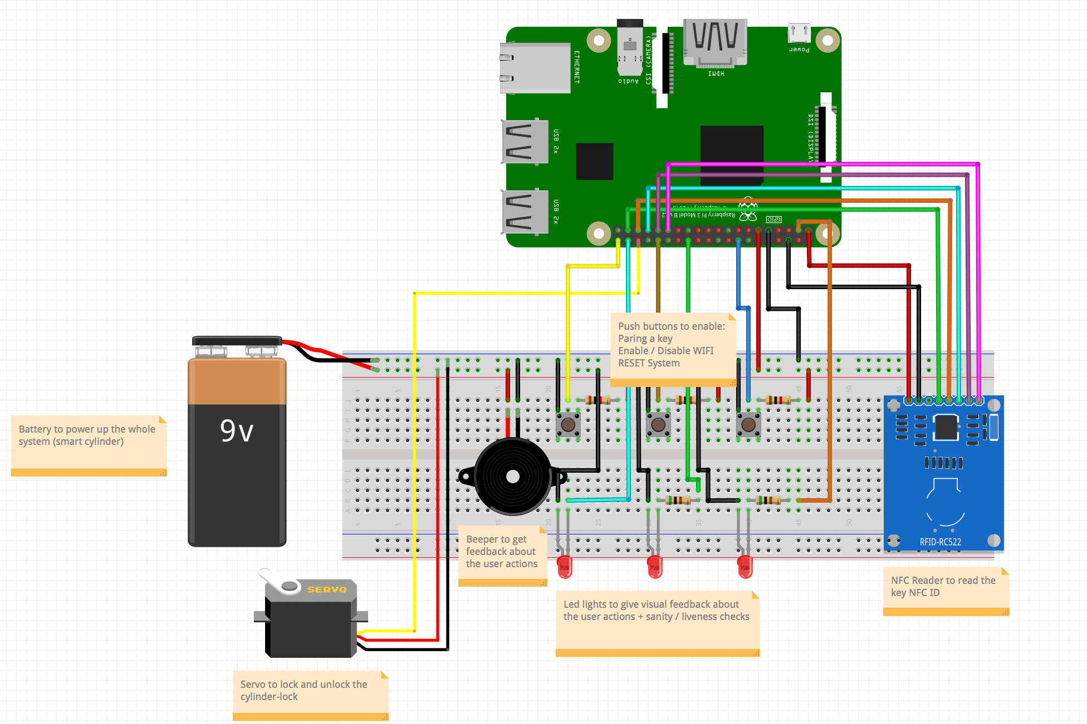
Product Description - Lockery lock
Fritzing Schema:

Slide 7
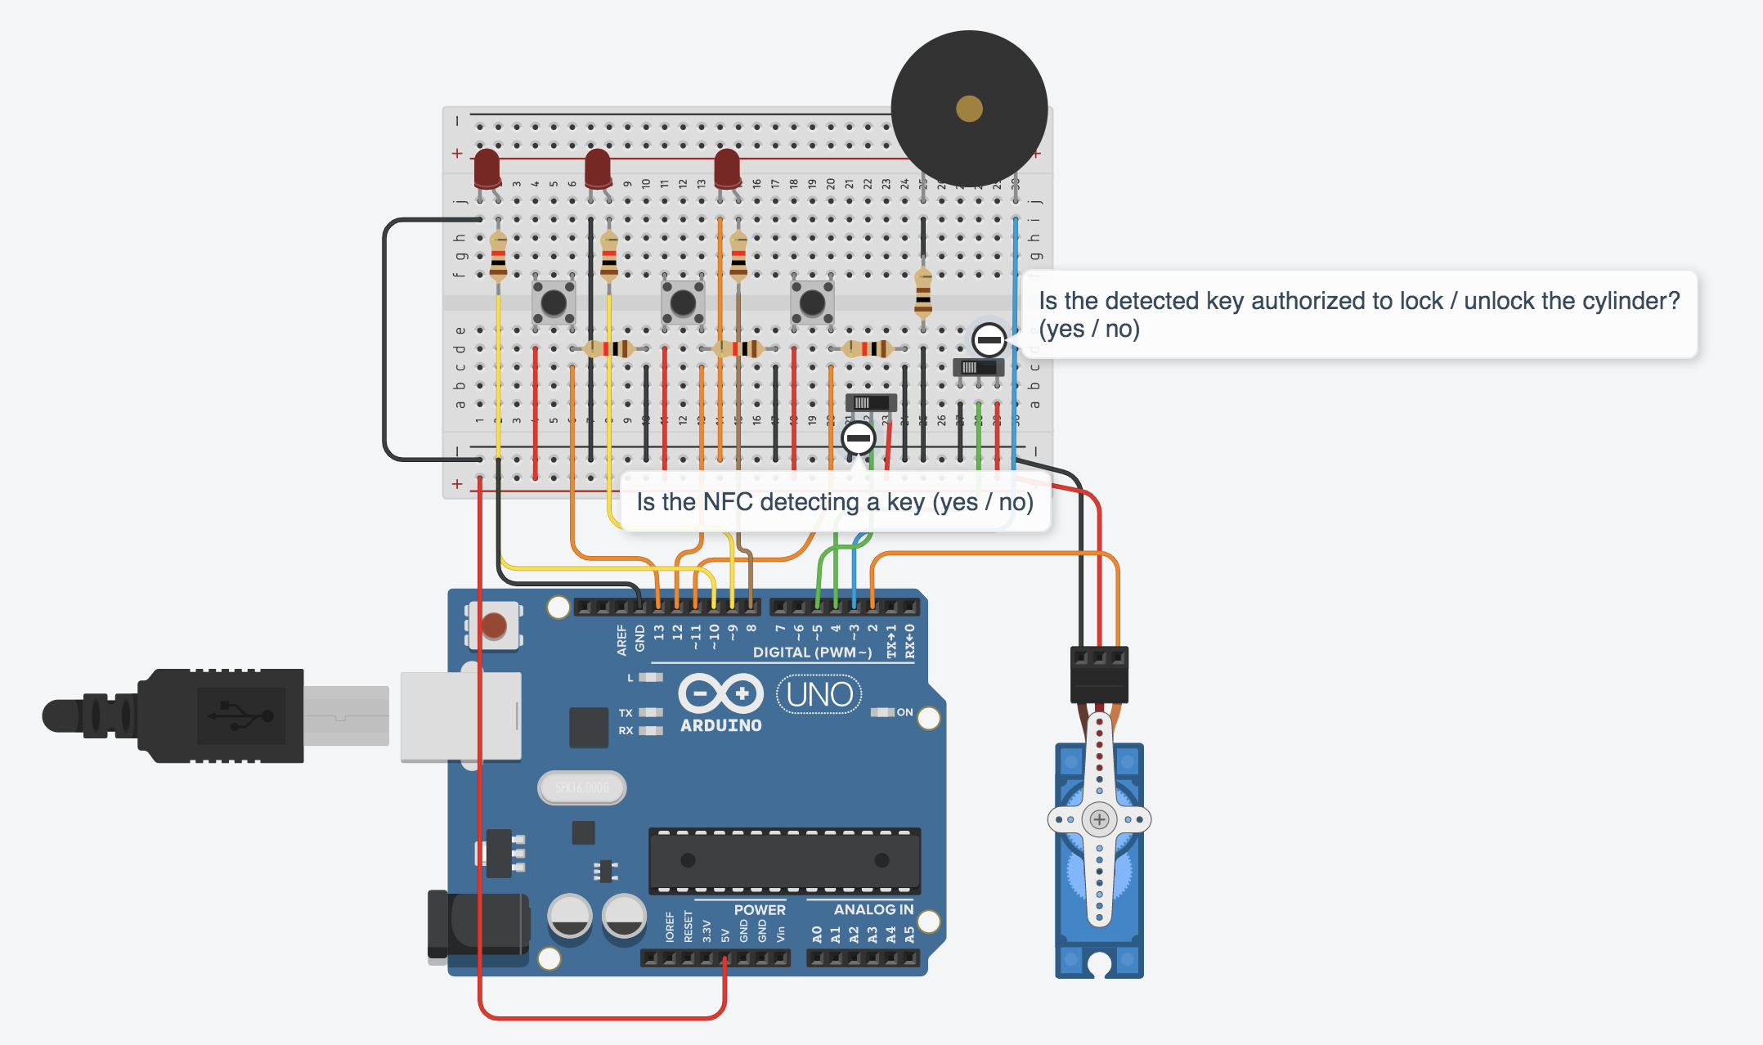
Product Description - Lockery lock
TinkerCAD Schema:

Slide 8
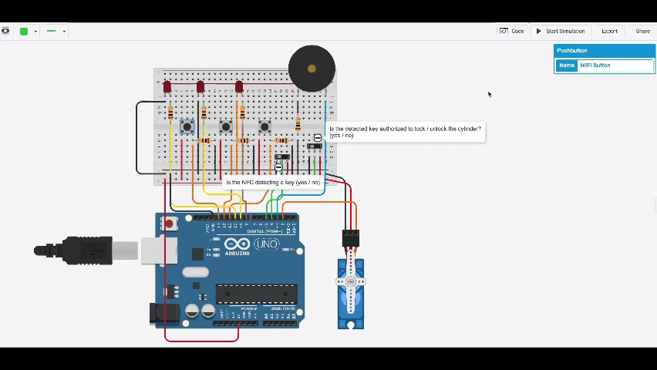
Product demo video - Lockery lock

Slide 9
Product Description - Lockery Key
The key is used to lock and unlock the Lockery lock. It looks like a normal key except 2 things:
The key’s blade is flat and has no notches or ridges
The key’s head has on one side a push button and a small RGB led and on the other side a fingerprint scanner

Slide 10
Product Description - Lockery Key
The key consists of:
1. RGB Led 2. NFC transmitter. 3. Fingerprint scanner 4. Push button 5. Arduino UNO

Slide 11
Product Description - Lockery Key
The key’s head contains a fingerprint scanner sensor on one side and a push button on the other side along with a RGB LED.
The push button is used to temporarily activate the fingerprint scanner in order to saves the keys’ battery life. To activate the fingerprint sensor the user needs to press and hold the button for 3 seconds.
To get an indication of the latest used cylinder lock state a single press on the push button triggers the LED indication. Locked state is red and unlock state is green.
Blue light of the RGB led indicates that the key waits for the user to place its finger on the fingerprint sensor.
The key’s blade contains an NFC sensor to pass its ID and / or the fingerprints hashes to the Lockery lock.
The key has no internet connection.
The key needs a small 5V CR battery to power the electrical components

Slide 12
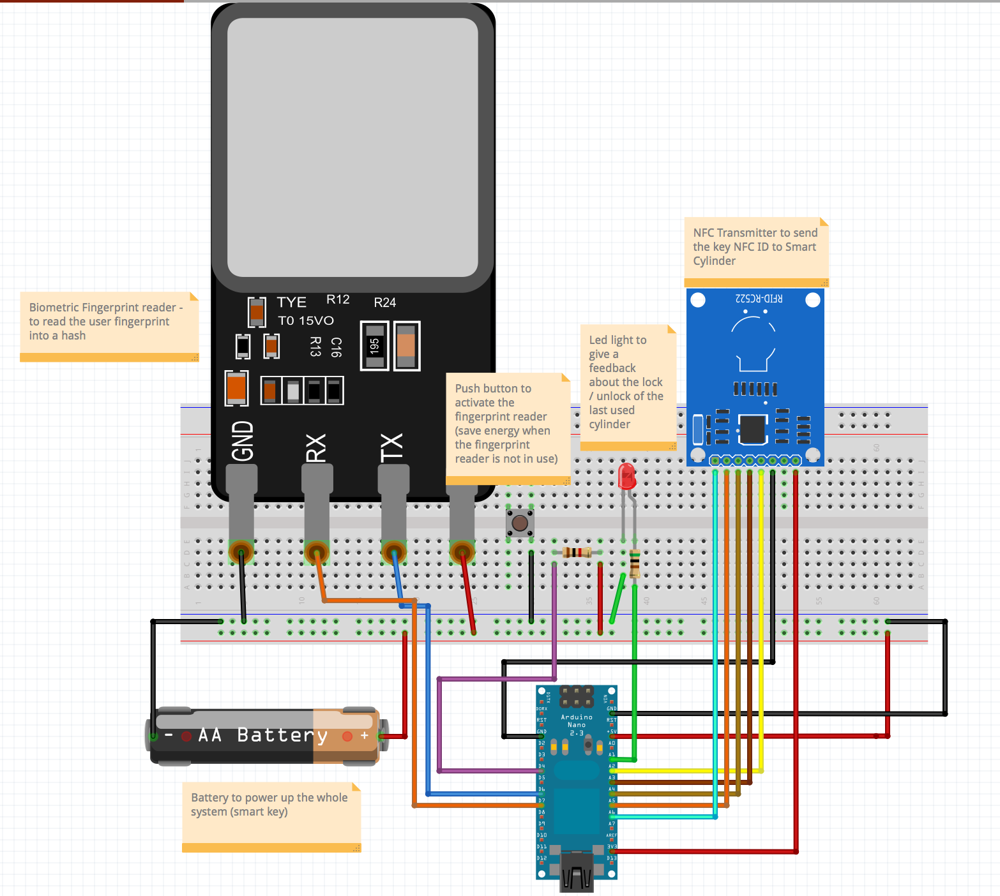
Product Description - Lockery Key
Fritzing Schema:

Slide 13
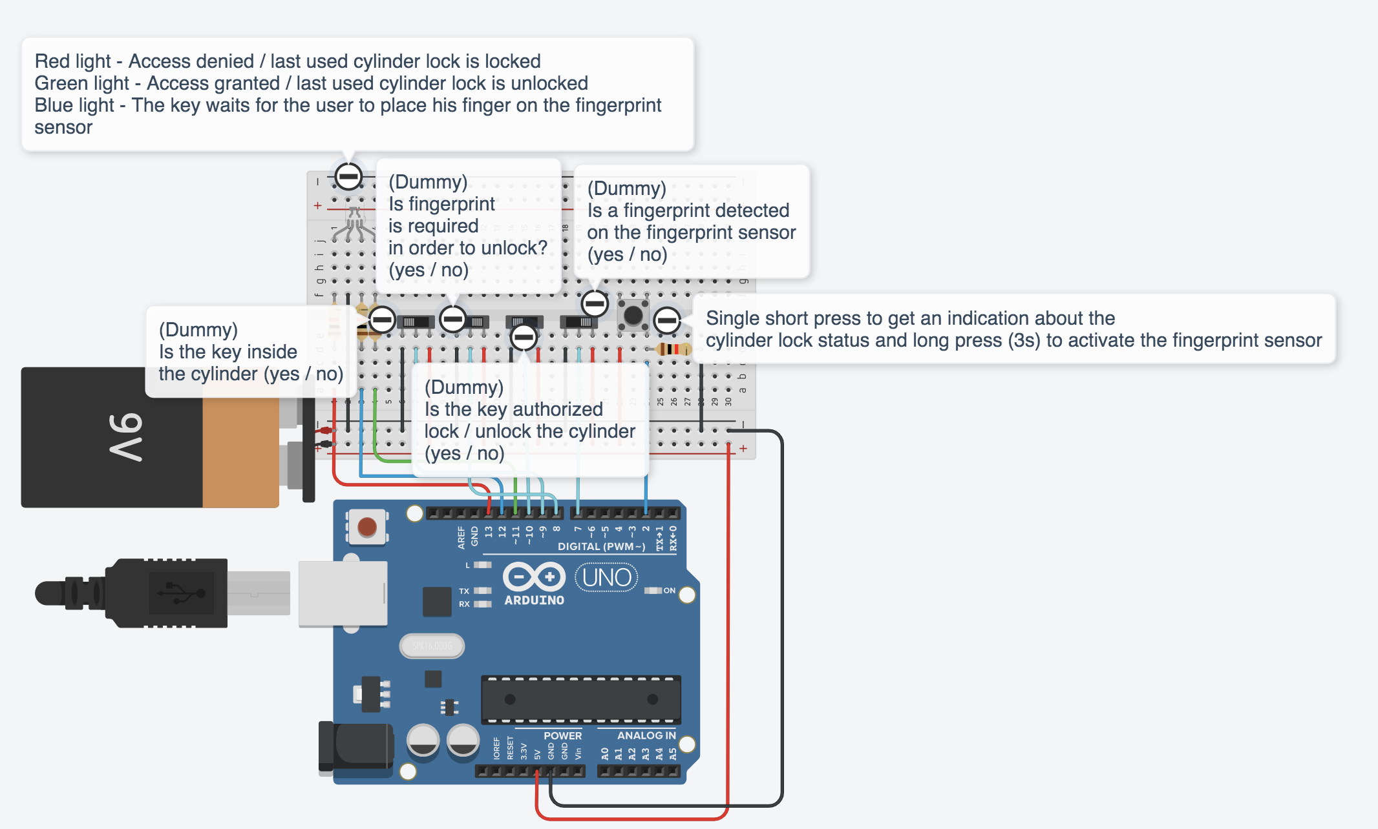
Product Description - Lockery Key
TinkerCAD Simulation:

Slide 14
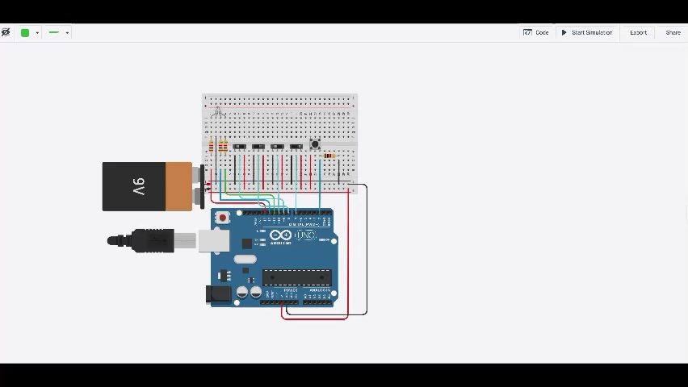
Product video demo - Lockery Key

Slide 15
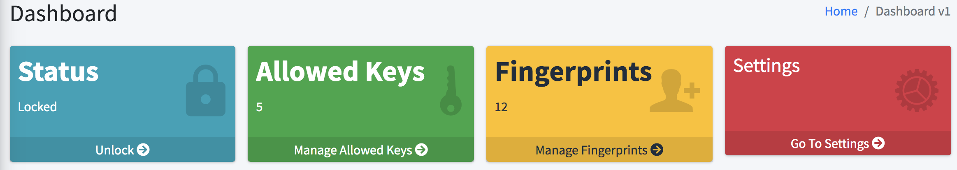
Potential DASHBOARDS FOR CLIENTs

Slide 16
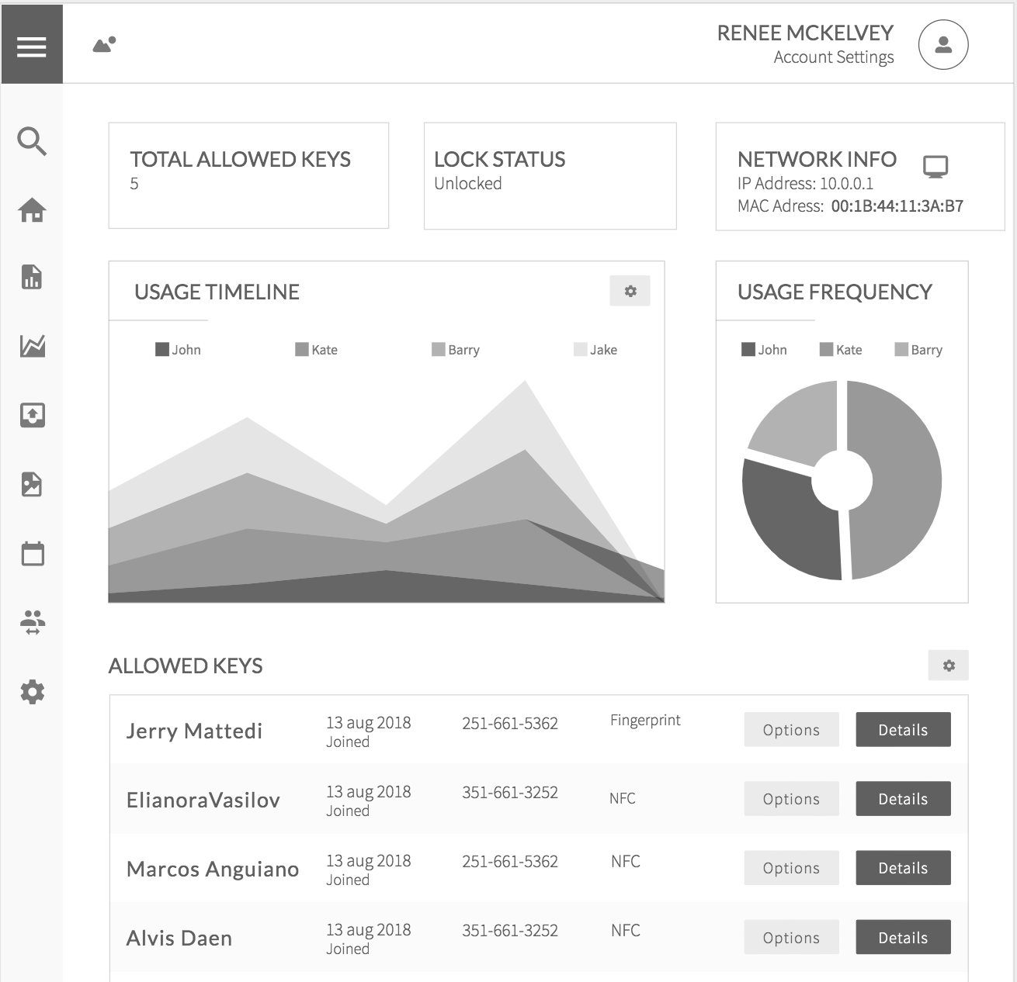
Potential DASHBOARDS FOR CLIENTs

Slide 17
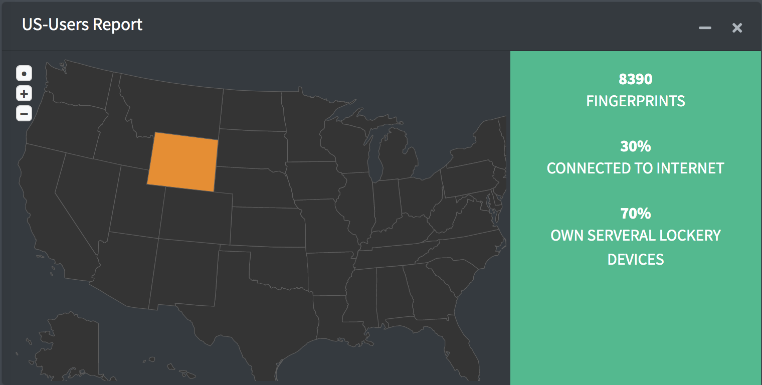
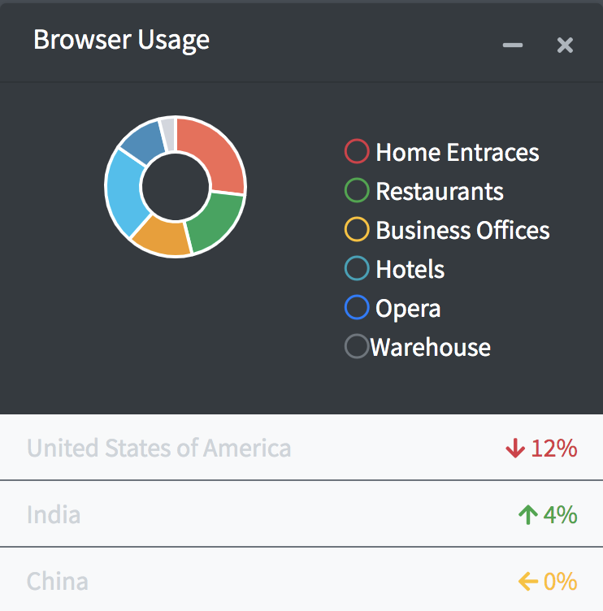
Potential DASHBOARDS FOR 3rd parties

Slide 18
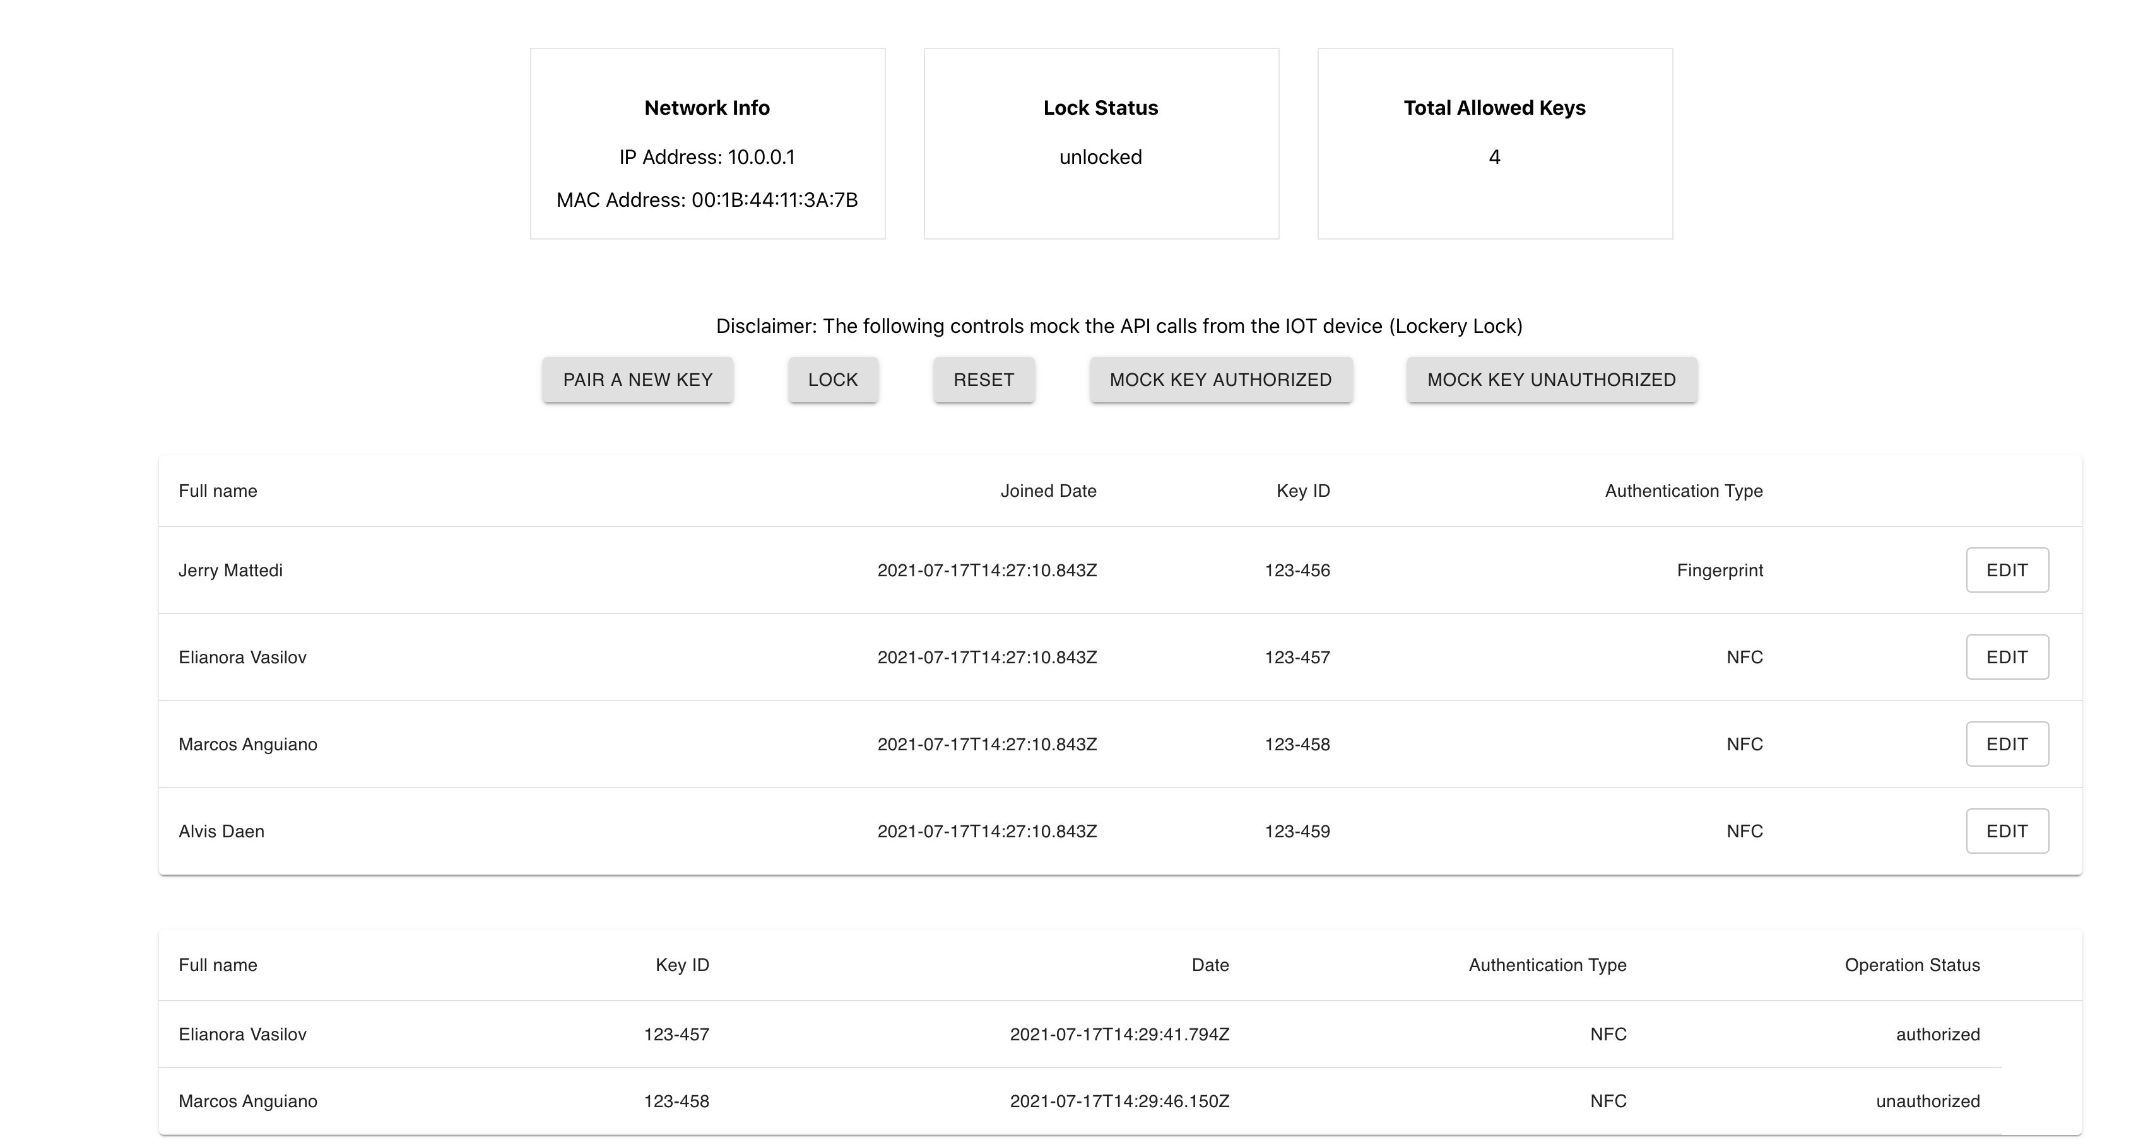
Demo dashboard
The code is hosted on my github repository

